Slide 1
FCN4 Regional Meeting
May 20, 2025
Family Council Network 4
Committed to Improving the lives of Ontario Residents in Long Term Care
www.network4longtermcareadvocacy.com

Slide 2
Family Council Network 4 13th Zoom Meeting 58th Regional Meeting).
This is the place to:
Exchange … “promising / best practices”
Share … .....achievements, issues and concerns
Discuss …... how to be effective advocates
Learn …...... about common issues

Slide 3
Your Voice is important
FCN4 goal is to listen and advocate for issues most common to families in regional LTC homes

Slide 4
Hug the Staff at your home
PSW DAY – May19th in Ontario
“PSWs are not just support—they are care”.

Slide 6
Advocacy Team Update
Collaboration: Champlain, Ontario North Networks, Kingston
Successful meeting with LTC Minister Natalie Kusendova- Bashta in Sept 2024
Requesting follow-up meeting after remaining Maternity Leave (fall 2025?): Paul Calandra is acting minister
Published newsletter: Fall 2024 & May 2025
Regional Meeting Nov 2024
Webpage: check-in for new resources and newsletters

Slide 7
Post election Focus of Advocacy?
Provincial | Federal
Funding that supports care hours (Is 4 hours still accurate?) | Transfer payments
Staffing Crisis (living wage, agency, retention, education funding, excessive OT) | Reciprocity health care workers
Capacity (growing wait list, progress of new and redeveloped space, non institutional builds, spousal accommodation, impact of Bill 7) | Uphold Canada Health Act
Person-centered care as a standard | Transparent collaboration gov’t. levels
Quality & Authority (Inspection process focus improvement, penalty consistent, operators license based on performance) | National standards
What else? | What else?

Slide 8
Posted April 30th Santis

Slide 9
Collaboration: Networks
CAWG - CARP Workgroup LTC (Ottawa Chapter)
See webpage and blog https://changeltcnow.ca
Monthly webinars focus on advocacy for innovative models of care that support person centered care and development of small homes.
Goal: influence to change LTC Institutional to “Home”
Encourage homes currently using or implementing an innovative model of care to share your journey

Slide 10
Collaboration: Research
Approved to participate in research on culturally sensitive food service
4 - year Grant / 3 provinces
Recruiting sites for interview – do you have residents with Black / Caribbean heritage?

Slide 11
Concern: Inspections
MLTC webinar Oct 1,2024 review of process changes
Training of new inspectors and review of entire process with eye on quality / safety /each inspector to be responsible for 2 homes
Advocating for:
Standardization & focus on positive sharing of practices and processes to achieve quality
Fairness in penalty for repeated non-compliance
Are Family Councils receiving reports?

Slide 12
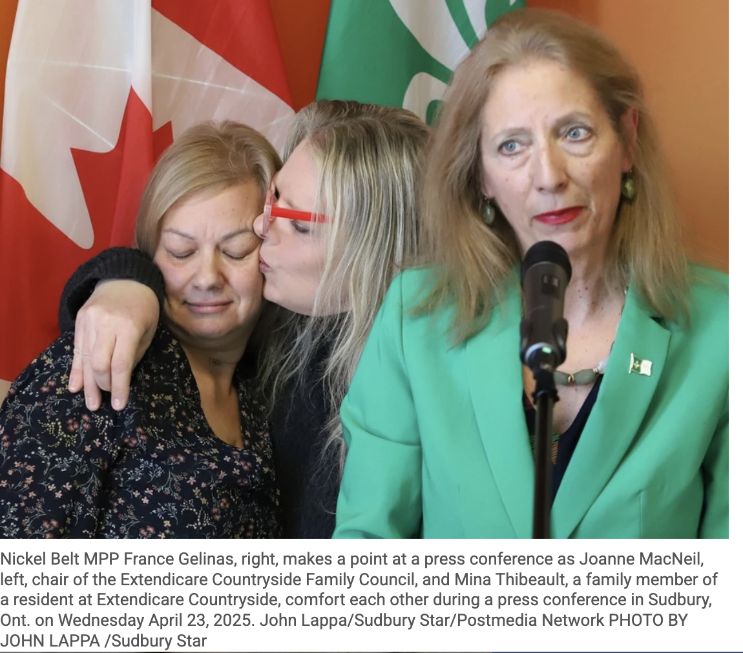
Concerns: inequality
Sudbury Home: Order to stop admissions Dec 2024
Kusendova-Bashta: Inspectors continue to monitor closely. “This order will not be lifted until we are confident the home has met our standards and can keep compliance going forward”.
Extendicare’s CAO, assured that the company is working to fix the problems, including recruiting more staff

Slide 13
Concerns: Staffing & retention Progress report?
Pillar 2: Hiring and retaining more staff (LTC Staffing Study July 2020)
The plan focused on six key areas of action:
increasing staffing levels
disrupting, accelerating, and increasing education and training pathways
supporting ongoing staff development
improving working conditions
providing effective and accountable leadership
measuring success

Slide 14
AGENCY USE FOR STAFFING – A NATIONAL PROBLEM =$9.8B SPENT 10 YRS CAN FOR PROFIT AGENGIES BE PHASED OUT?
"I understand the importance of phasing out agencies — and I do agree with it. But it can't be done if we don't first address the root cause of the exodus, the hemorrhage of nursing in the health-care system"
"We need to stop looking at it as a shortage of nurses, and start looking at it as a shortage of decent working conditions.”
CBC News · Posted: May 12, 2025 4:00 AM EDT

Slide 15
Concerns: Capacity
Progress?? Hard to do the math......
“As of March 2024, the ministry has 110 projects open, under construction, or approved to construct for a total of 18,204 beds”
How many have turned in their license due to cost to meet current standards (e.g. air conditioning)?
https://www.ontario.ca/page/published-plans-and-annual-reports-2024-2025-ministry-long-term-care

Slide 16
Good News

Slide 17
Promising PraCTICES
Ontario Health’s Local Priorities and Education and Training Funding MLTC
Peel Region saw improved health outcomes and a promising reduction in hospital transfers by expanding point-of-care testing (POCT) across all five of its LTC centres.
Diagnostic tools, including hemoglobin and c-reactive protein metres, urinalysis, bladder scanners, and blood analysis systems.
135 long-term care staff were trained to use them.
Collect accurate data and assess the benefits of point-of-care testing, Peel Region also developed a new system for monitoring emergency department transfers.
https://peelregion.ca/press-releases/point-care-testing-long-term-care-reduces-hospital-transfers

Slide 18
Promising Practice – AI in LTC

Slide 19
Up Coming
June 11-12 – Presentation Networks
Cathleen Edwards- manager Education

Slide 20
WANT AD: RECRUITING
ADVOCACY TEAM MEMBERS
Variety of skills welcomed – but mostly passionate about quality of LTC with the network to share the workload and infuse new ideas
Techie skills
Articulate the resident needs and solutions
Send an email – let’s chat

Slide 21
Suggest Topics for next regional meeting
Speaker?
Round Table Discussion of Hot Topics?
Tips on how to advocate strategically?
Face to Face ever again?
Bring your promising practices that have been successful!

Slide 22
Keep in Touch
Web page:
www.network4longtermcareadvocacy.com
Email to request Newsletters: advocacyFCN4@Protonmail.com

Slide 23
Sharing your voice, issues and questions
is so important!
Promising Practices : Your Turn!

