Slide 1
A Day in the Life of a PSW
Presented by the Ontario PSW Association

Slide 2
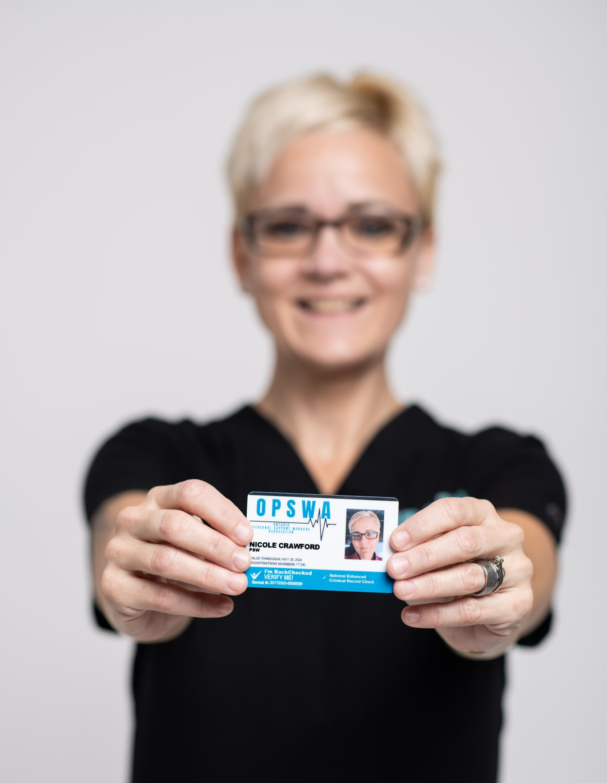
The Personal Support Worker (PSW)
The Personal Support Worker plays a pivotal role in the delivery of health care across all settings and as such a description of a daily routine presents some difficulties.

Slide 3
Personal Support Worker & LTC
Health care professionals' routines are shaped by patient needs and care requirements and, when applicable, regulatory and legislative requirements.
For the benefit of this presentation, we will be providing a general overview of the pattern of the daily life of the PSW based on the care setting of the patient.

Slide 4
Long Term Care in Ontario
Daily Life of a PSW in Long-Term Care (LTC)
Highly time-sensitive work environment
Day typically begins with waking up residents
Main Shifts in LTC:
Morning Shift
Afternoon Shift
Overnight Shift
Additional Roles/Shifts (varies by facility):
Bath Nurse – Responsible for resident hygiene and bathing
Float PSW – Assists where needed throughout different units or tasks

Slide 5
Morning Shift – Early/mid Morning
Morning Shift Routine – PSW Duties
Arrive at least 30 minutes before shift begins
Shift debrief with overnight staff
Morning Resident Care:
Wake up residents and assist with the morning routine
Help dress
Assist with toileting
Change incontinence products
Wash face, underarms, and peri area
Brush teeth or clean dentures
Apply body lotion
Brush hair
Additional Duties:
Assist fellow PSWs with lifts and transfers
Load residents into the dining room
Assist with feeding residents who need help
Return residents to their rooms after meals
Toilet if needed
Shower residents on the designated list for the day

Slide 6
Morning shift – late morning/early afternoon
Snack cart: Comes around late morning
Restock personal care carts:
Replenish required briefs and peri cloths in each resident’s room
Documentation:
Fill out daily care reports for each resident
Resident support:
Assist residents who want to attend events in the common area
Prepare for lunch:
Get residents ready
Bring all residents to the dining room
Assist with feeding as needed
Post-lunch care:
Take residents back to their rooms
Transfer them to bed or toilet
Perform personal care tasks
Final documentation:
Complete daily care reports for each resident
Shift handoff:
Debrief with Afternoon Shift staff

Slide 7
Afternoon – early evening shift
Ensure all residents have the required incontinence products/pre-clothes
Take the snack cart around to all residents
Assist residents with toileting and transfers
Escort residents to events or back to their rooms afterward
Begin preparing residents for dinner
Assist residents to the dining room
Help feed residents as needed
Return residents to their rooms.
Escort interested residents to event in common area.
Begin bedtime preparations.
Shower residents on your list.Put residents to bed, one at a time.
Assist coworkers with lifts/transfers.
Complete daily care documentation.
Complete secondary checks and brief changes
Restock personal care carts.
Stock resident rooms with briefs and peri cloths.
Retrieve residents from common area and assist to bed.
End-of-shift report and debrief with overnight staff.

Slide 8
Overnight Shift
Do rounds in each resident’s room
Answer call bells as needed
Reposition residents every 2 hours (Q2H)
Help residents who wander or experience sundowning
Restock carts and the utility closet
Complete daily care reports(In some homes).
Fold and put away laundry
Clean 5 or 6 wheelchairs nightly
Early rising residents – help get them ready for the day
Debrief with morning staff

Slide 9
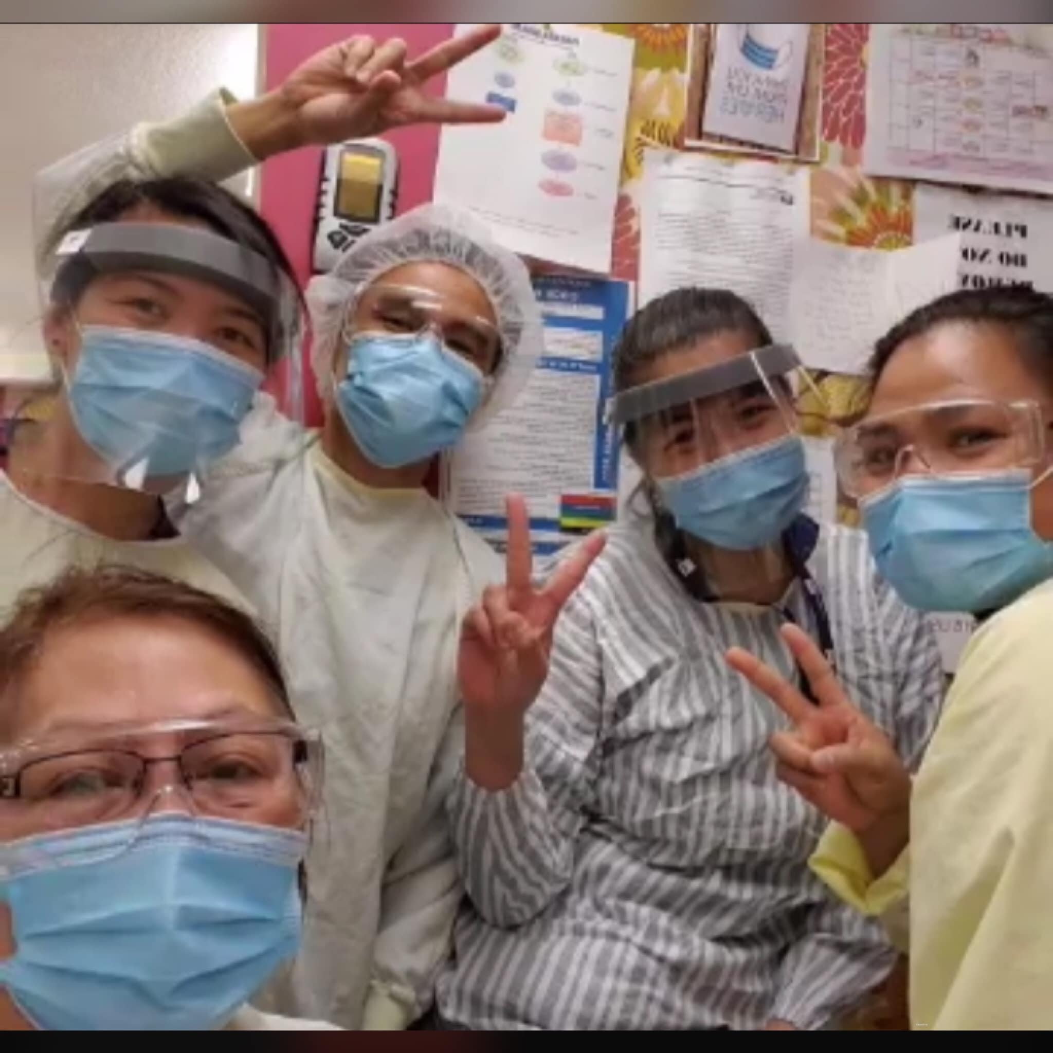
The Other Side of PSW Duty
The majority of PSWs are women, often single mothers aged 30 and older.
Many PSWs are employed in multiple part-time roles to earn a livable income.
PSWs report working short-staffed in 91% of their shifts.
The profession experiences a high rate of physical and emotional burnout.
PSWs often face competition from agency staff, who may not be held to the same training or qualification standards.
Inconsistent staffing and pay disparities between agency and in-house workers contribute to job dissatisfaction and retention challenges.

Slide 10
Random Events: What Can Happen and What Does Happen
Family members visiting residents
Families requesting immediate attention or care
Families interrupting staff duties
Resident death
Communication from hospitals
Staffing shortages
Infectious disease outbreaks
Security breaches or unauthorized individuals on the premises
Fire emergencies
Changes in medications or adverse drug reactions
Admission of new residents
Interpersonal conflicts between residents

Slide 11
The Ontario PSW Association
www.opswa.ca
info@opswa.ca

